Slide 1

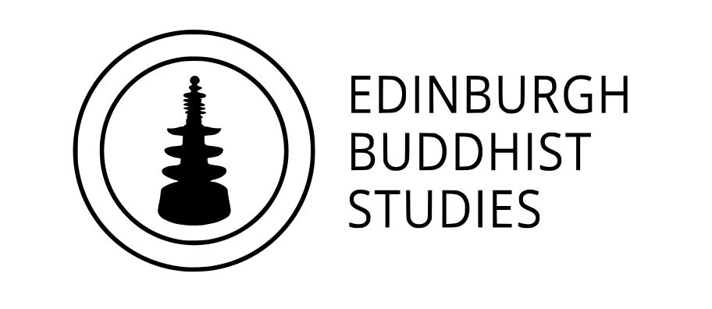



Who is the Buddha?
Dr Naomi Appleton
University of Edinburgh, naomi.appleton@ed.ac.uk
Dr Chris Jones
University of Cambridge, cvj20@cam.ac.uk

Slide 2
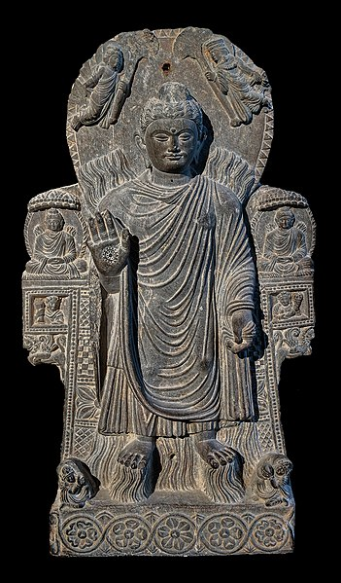
Programme
January 27th The Buddha: Historical Figure or Literary Character?
February 3rd The Buddha as Philosopher
February 17th The Buddha as Social Reformer
February 24th The Buddha in Buddhist Practice
March 10th The Buddha among Buddhas
March 17th The Buddha in Modern Britain
Each session will consist of roughly 45 minutes of presentation, and up to 30 minutes of questions and/or discussion.
The presentations (though not the discussions) will be recorded. Please keep cameras off during this part of the event.
Image copyright the Musée Guimet, Paris
Notes:
The image is another Buddha from Gandhāra, dated to roughly the third century CE. See slides in the first session for more on this region.
Undoubtedly, the Buddha in early Buddhist literature often engages with his followers, as well as other teachers and thinkers, as something like a philosopher, and teachers or persuades them through argument and critical thinking (for example, in discourses [suttas] preserved in the Pāli Canon). However, he is also no stranger to the use of conversion through spectacle. The Buddha is here depicted performing the ‘double miracle’ of producing both fire (from his upper body) and water (from his lower body) at the same time, which he is reported to have done to impress and demonstrate his superiority over rival teachers, whose supernatural powers were not so great. This relates to the very ancient Indian idea that the achievement of ascetical or intellectual prowess correlates with the achievement of supernatural power/s.

Slide 3
The Buddha as a philosopher
[The Buddha] lived, he taught, and he died as a philosopher…’
Eugene Burnouf, Introduction to the History of Buddhism, 2010: 329
(translation of the originally French text, published 1844)
Somewhat problematic
(not what Theravāda means, for a start…)
…Buddhism in its original form, and still in the Theravada (Small Vehicle) form, is a philosophy, not a religion. So is Jainism, so most emphatically is Confucianism. The differentiator is that these philosophies are not centred upon belief in, worship of, and obedience to a deity or deities, from whom or from which come the commands that construct the correct form of life and belief for the devotee.
A.C. Grayling, The God Argument: The Case Against Religion and for Humanism, 2013: 36 (e-book)
Notes:
Burnouf’s 1844 Introduction à l’histoire du Buddhisme indien was the first Western, book-length introduction to Buddhism, Indian or otherwise. Understandably, it has been an incredibly influential work; also understandably, much of what it has to say about Buddhism is now somewhat dated. Burnouf is perhaps significant for having been an early author to write about the Buddha not as a founder of a religious tradition, or anything like a ‘messianic’ revealer of truths, and more as a ‘philosopher.’
Grayling’s 2013 book goes on to refer to Buddhism ‘in its original Theravāda form’ (p.299), which repeats a common error: no scholar believes Theravāda Buddhism to be the ‘original’ form of Buddhism, for myriad reasons, and even teachers in the Theravāda tradition concede that their traditions is not exactly the same as what existed in India over two thousand years ago. Be cautious when it comes to statements about Buddhism made by learned specialists in other academic fields!

Slide 4
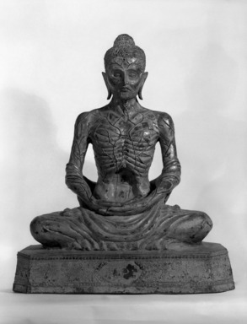
The ‘late-Vedic’ (C8-5th BCE) context of early Buddhism in India
brāhmaṇa – a ritualist, educated in the Vedas and in sacrifice, who presumes himself to be superior to others in society by virtue of birth (English ‘brahmin’)
śramaṇa (Pāli samaṇa) – a renouncer (often an ascetic), who has quit the world of normal social conventions (house, family, ritual etc.), and sought a response to the human condition
Image copyright the Brookyln Museum.
saṃsāra – ‘wandering on’: the beginningless process of birth, death and rebirth, to which we are all bound, fueled by karma
karma (Pāli kamma) – ‘action’ or ‘activity’ that maintains our bondage to saṃsāra
Notes:
Some sources (for example, Richard Gray’s WJEC/Eduqas AS textbook Buddhism) present the Buddha as having been born into an India already home to something reliably called ‘Hinduism’. This is a problematic claim: for one thing, traditions of renunciation associated with Hinduism (for example the saṃnyāsin, as one of four stages of a Brahmin’s life) are undoubtedly features of later Indian history. It is more accurate, perhaps, to say that Buddhism emerged in an India that knew Vedic religion and traditions of ‘Brahmanism’, which are foundational for what scholars eventually call ‘Hinduism.’
The image is a C19th depiction of the Buddha, from Thailand. This is the emaciated Siddhārtha Gautama, prior to his awakening and after years of self-denial as an ascetic. In other words, it depicts the Buddha before he is the Buddha, and moreover represents his tremendous commitment to self-denial, but is not supposed to be indicative of how Buddhists are themselves supposed practice.

Slide 5
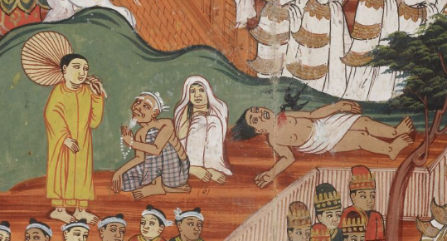
The Buddha in his context
The four sights
Early meditation teachers
Ascetic practice and the “middle way”
Companions and followers
First five monks
The four sights (old age, sickness, death and a mendicant) as depicted on British Library manuscript OR14297, from 19th century Myanmar.
Notes:
You can see the rest of the manuscript online, and perhaps you will find other scenes from the Buddha’s lifestory to use in your class: http://www.bl.uk/manuscripts/FullDisplay.aspx?ref=Or_14297
For the best available account of the Buddha’s lifestory see John S. Strong, The Buddha: A Beginner’s Guide (Oneworld, 2009, previously published as The Buddha: A Short Biography in 2001).

Slide 6
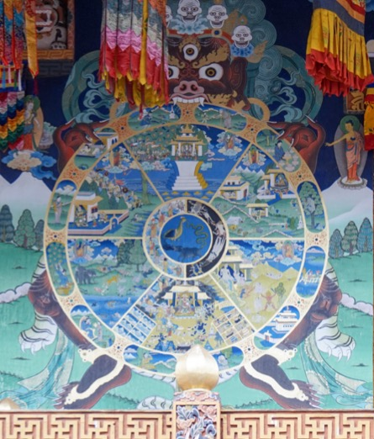
Karma: an idea in context
Rival views:
Karma doesn’t really operate
Karma can be controlled or eliminated through ascetic practice
What is good and bad karma depends on your status, role and ritual obligations
Buddhist karma:
Universal ethic
“karma is intention”
Notes:
For a useful selection of Pali teachings about karma, including the famous declaration that “karma is intention” in the Nibbhedika Sutta, see: https://www.accesstoinsight.org/ptf/dhamma/sacca/sacca4/samma-ditthi/kamma.html
The importance of Buddhist association of kamma with the mind cannot really be overstated. Although Buddhist cultures and authors understand kamma in different ways, the dominant trend in Buddhism has understood that in order to affect one’s future one must work upon the mind with the mind, to eliminate foundational, corrupting mental characteristics (desire, attachment, ignorance etc.) that inform our deeds, utterances and thoughts. Seeing as the mind is what matters, Buddhism has long invested in practices aimed at transforming the mind in its most basic functions from a defiled to a ‘cleansed’ state; such practices come under the broad umbrella of what in English has come to be called ‘meditation’.
The Bhavacakra motif dates back to at least the middle of the first millennium CE in India, although the ideas expressed by it all date to the foundations of Buddhism. It is sometimes referred to as a ‘Tibetan wheel of life’, because the image has remained particularly popular and prevalent in Tibetan Buddhist iconography.
The image here is the Bhavacakra at Punakha Dzong, Bhutan, by Bernard Gagnon, CC-BY-SA, https://commons.wikimedia.org/wiki/File:Punakha_Dzong,_Bhutan_29.jpg
For a textual source that might usefully accompany a discussion of the wheel see https://blogs.ed.ac.uk/teachingbuddhism/2021/04/01/story-of-the-image-of-the-five-sectioned-wheel-of-rebirth/
The famous texts on the fruits of the mendicant life (the Sāmaññaphala Sutta of the Pāli Canon) includes teachings from six rival teachers to the Buddha, including key ideas about karma. See here for a full translation: https://www.accesstoinsight.org/tipitaka/dn/dn.02.0.than.html
For another source through which to teach the Buddhist approach to karmic fruiting, in particular as a rebuttal to fatalist teachings and the moral issues that raises, see “The Fatalist King and the Divine Sage” story here: https://blogs.ed.ac.uk/teachingbuddhism/2020/03/31/understanding-religion-through-story-project-resources/
And if you want to know more about how karma was understood across different contexts then try Johannes Bronkhorst’s book Karma in the University of Hawaii Press “Dimensions of Asian Spirituality” series, 2011.

Slide 7
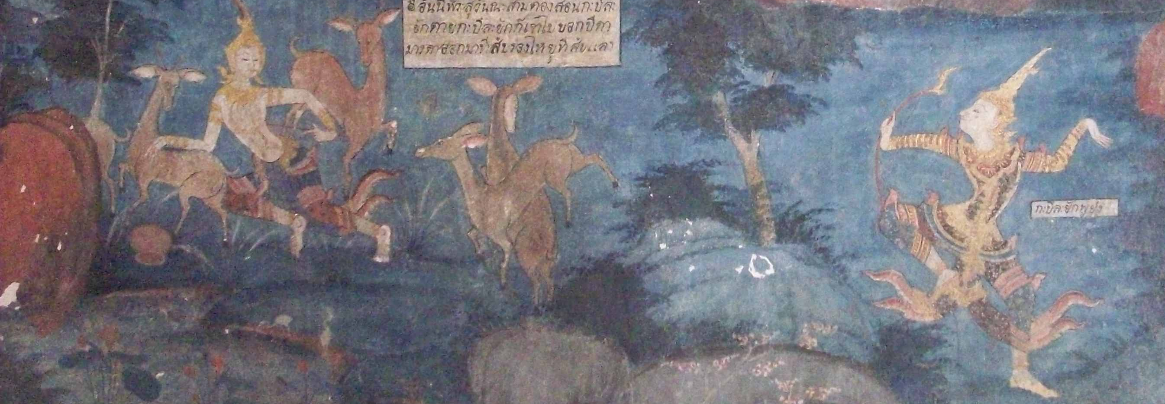
“It's just as if a man were wounded with an arrow thickly smeared with poison. His friends & companions, kinsmen & relatives would provide him with a surgeon, and the man would say, ‘I won't have this arrow removed until I know whether the man who wounded me was a noble warrior, a brahman, a merchant, or a worker.' He would say, 'I won't have this arrow removed until I know the given name & clan name of the man who wounded me... until I know whether he was tall, medium, or short... […] until I know whether the bow with which I was wounded was a long bow or a crossbow... until I know whether the bowstring with which I was wounded was fiber, bamboo threads, sinew, hemp, or bark... […]’ The man would die and those things would still remain unknown to him.”
Text from the Māluṅkyovāda Sutta, trans. Thanissaro Bhikkhu: https://www.accesstoinsight.org/tipitaka/mn/mn.063.than.html#poison
Image: The shooting of Sāma, Wat Makham No, Thailand
Notes:
For a full translation of the Māluṅkyovāda Sutta, see https://www.accesstoinsight.org/tipitaka/mn/mn.063.than.html#poison
The image is a photograph by Naomi Appleton and free to use for educational purposes. It depicts a past-life story of the Buddha, in which he is a young ascetic shot by a king. The temple, Wat Makham No, is in Suphanburi Province, Thailand.

Slide 8
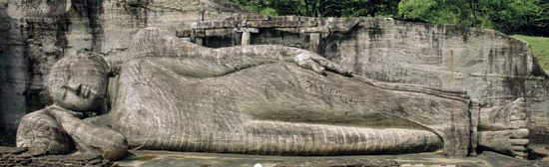
The Three Marks/Characteristics (tilakkhaṇa)
dukkha – suffering; the fact that things are ‘unsatisfactory’
anicca – impermanence
anattā – ‘not-self’ or ‘without self’
Right: the Buddha’s death or parinibbāna, Polonnaruva, Sri Lanka. Image in the public domain.
Notes:
The reclining Buddha at Polonnaruva (Sri Lanka) dates to the twelfth century and is a typical example of this image, which can be found across mainland and insular Asia. It depicts the Buddha on his deathbed, at which point he delivered his final teachings and – with the death of his physical body – attained what is sometimes called his ‘final nibbāna’, or parinibbāna, or in other words a complete end to his transmigration. Some of the Buddha’s final teachings reminded his audience about the transience of all things: so ubiquitous is impermanence that even the Buddha himself grew ill and died. One account of these events is the Pāli Mahāparinibbānasutta (https://www.accesstoinsight.org/tipitaka/dn/dn.16.1-6.vaji.html).
It should perhaps be noted that forms of Mahāyāna Buddhism understand the Buddha death differently – see notes on the Lotus Sūtra in the last session.

Slide 9
Five ‘aggregates’ or ‘heaps’ (khandhas) of experience
Physical form (rūpa)
Sensation (vedanā)
Conceptualizations (saññā)
Volitions (saṅkhāra)
Consciousness (viññāna)
Amidst which, one might erroneously think there to be something permanent, unchanging, and of existential significance, or one’s ‘self’ (attā)
Notes:
A wealth of more recent, Western philosophy has either drawn inspiration from or been recognized to resemble Buddhist teaching about absence of self: specifically, the hypothesis that personal identity is more accurately conceptualized in terms of continuities of transient events (physical and mental) localized at one place, from which emerges the notion of a self, rather than in terms of the existence of some fixed ‘centre’ to our identity that endures throughout one’s life. For just two examples, one might consider in this context writings by Derek Parfitt (e.g., Reasons and Persons), or Daniel Dennett (e.g., Consciousness Explained).
There are however some limitations to comparisons between these and Buddhist teaching about not-self, regarding which see notes to the next slide.

Slide 10
From the Anattalakkhaṇa-sutta
(‘Discourse [sutta] on the character [of things], being not the self’)
[The Buddha is seated with his first audience of monks, after having taught about the Four Truths, and asks his monks to interrogate the content of their experience…]
Monks, how do you conceive it – is i) physical form […then, each in their turn, ii) sensation, iii) conceptualization, iv) volition and v) consciousness…] permanent or impermanent?
…(The monks respond) Impermanent, venerable Sir.
Now, is what is impermanent unsatisfactory (dukkha) or pleasing (sukha)?
…Unsatisfactory, venerable Sir.
Now, is what is impermanent, what is unsatisfactory, being subject to change, fit to be considered like this: ‘this is mine, this me, this is my self (attā)’?
…It is not, venerable Sir…
Notes:
It should be noted that although there is much that is thought-provoking about Buddhist teaching regarding no ‘self’ anywhere in our experience, the ‘self’ in question here (attā, or Sanskrit ātman) is a notion particular to Indian thought two-thousand years ago rather than, strictly speaking, anything exactly like Western philosophical notions of selfhood, or Judeo-Christian notions of a ‘soul’.
The early Buddhist texts discussed here are responding to Indian musings on transmigration, which seems to have been accepted as an undesirable fact of existence by most Indian thinkers in the middle of the first millennium BCE. Transmigration, on face value, requires an enduring ‘something’, one’s ‘self’, that transmigrates. As is still taught in forms of Hinduism today, liberation from this process is premised on locating and knowing the self (ātman), which if properly known is a source of special knowledge and power. In a sense, Buddhist teaching about not-self (Skt. anātman) is a rejection not simply of a self but of this kind of thinking entirely: liberation is not a process of finding ‘what we properly are’ apart from everything about us that changes, but rather a matter of transforming what we most obviously are from one state (ignorant, desirous, transmigratory) to another (informed, detached, liberated).

Slide 11
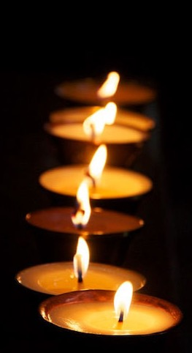
From the Milinda-pañha
(‘The questions of the King Milinda’, in dialogue with the monk Nāgasena)
The king asked: ‘Venerable Nāgasena, is it the case that one does not transmigrate, and yet one is reborn?
Yes, your majesty, one does not transmigrate and yet one is reborn.
How, venerable Nāgasena, is it that one does not transmigrate and yet one is reborn? Provide an analogy.
Just as, your majesty, if someone kindled one lamp from another, is it indeed the case, majesty, that the lamp would transmigrate from the other lamp?
Certainly not, venerable Sir.
Indeed not, your majesty, one does not transmigrate, and yet one is reborn.
Notes:
The Milindapañha is a celebrated text likely composed in the first century BCE; it does not involve the Buddha himself, but focuses on the debate between the monk Nāgasena and the inquisitive king Milinda. Milinda himself is likely based on the King Menander I, a Greek-speaking king who ruled Bactria, the easternmost region of the Hellenic Greek world (roughly modern-day Afghanistan/Pakistan) in the second century BCE.
This material from the Milindapañha (ref. 3.5.5), as well as other extracts from this relatively long text, can be found here: https://www.accesstoinsight.org/tipitaka/kn/miln/miln.intro.kell.html. Another famous portion of the text (3.1.1) sees the monk Nāgasena compare a human being to a chariot: in the manner that we only ascribe the word ‘chariot’ to a conjunction of wheels, axel, carriage, yoke and other components, although nothing amidst these can be called ‘the chariot’, so too do we refer to a person only by knowing there to be a physical body, sensations, conceptualizations, volitions and consciousness (see next slide) in one place: the referent ‘person’ is not hidden among its components, but rather depends upon them for its existence.

Slide 12
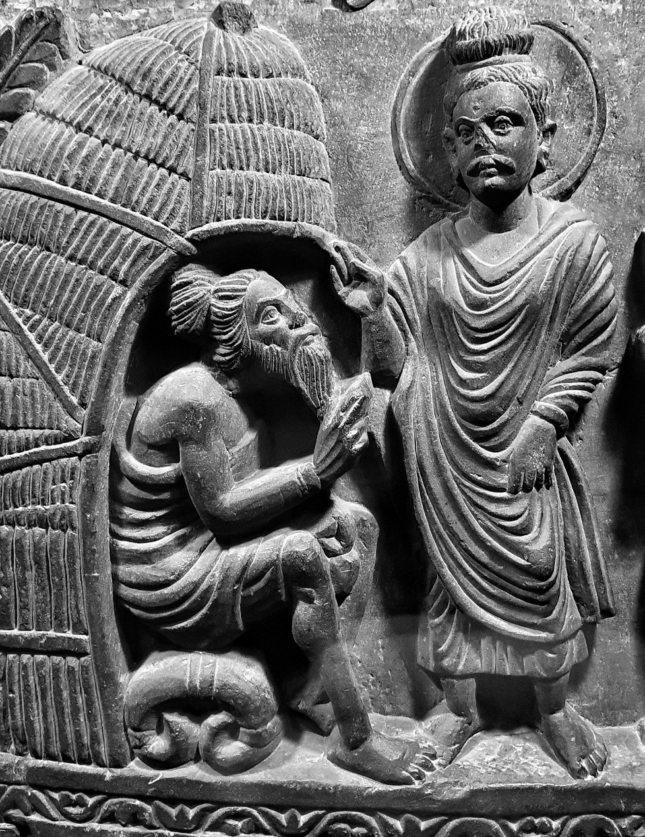
Conclusion
Buddhist literature is full of what we might call ‘philosophy’, if by this we mean engagement with philosophical problems (human nature, identity, ethics, etc.) in philosophical ways (analytic, inferential, etc.), although the Buddha speaking in this literature is pretty clear that not all philosophical topics are worth worrying about, given the central aim of Buddhist teaching: removing oneself from the cycle of rebirth, and attaining an end to suffering.
Left: Detail of a C2nd relief from Gandhāra, depicting the Buddha in conversation (or debate?) with a Brahmin. Image copyright Peshawar Museum, Pakistan.
Notes:
This session has tried to remain focused on the Buddha as philosopher, and Buddhism as philosophy, in early Buddhist thought. What we have not touched are any of the incredibly influential (sometimes mind-bending) traditions of philosophy that developed later in Buddhist circles, in India and beyond, for example:
* Abhidharma – the very broad tradition of unpacking the different things that exist (‘ontology’) according to early Buddhist discourses.
* Madhyamaka – the Mahāyāna Buddhist school dedicated to exploring an enigmatic ‘middle’ position between affirming the existence and non-existence of things
* Yogācāra – often presented as an ‘idealistic’ school of Mahāyāna Buddhist thought, which holds that the basis for our reality is the distorted imagination of our minds.
Buddhist philosophers in India were also particularly stimulated by epistemology: the study of how we can arrive at reliable knowledge about anything. All of these traditions in Buddhism understand the Buddha to be their guiding authority, but none would crudely reduce the Buddha to what we in the West would simply call ’a philosopher’.

